Slide 1
AI Resume Builder Intelligent Resume Generation System Group Project 2: Week 4 Presented by: Duduzile MGCINA , Kutlwano KUAPE, sukoluhle NDLOVU, Nombulelo OLIFANT, Thandazile NCAMISO

Slide 2
Introduction & Project Overview
Project Overview
Goal: Develop an intelligent resume generation system.
Purpose: Create customized, ATS-friendly resumes based on user inputs.
Core Idea: Leverage AI to streamline and optimize the resume creation process.

Slide 3
Introducing the AI Resume Builder
The AI Resume Builder is a sleek and intelligent web app that helps users generate professional resumes — with a touch of AI. Built using HTML, Tailwind CSS, and JavaScript, it allows users to customize layout, fonts, and colors, then generate smart content using the OpenAI API.
Key Features ✨
Customization: Choose custom fonts and theme colors.
AI-Powered Summary: Auto-generate a professional resume summary with the OpenAI API.
Comprehensive Sections: Include sections for education, experience, projects, certifications, skills, and more.
PDF Export: Export your resume as a PDF with a single click.
Responsive Design: Fully responsive design using Tailwind CSS.
Privacy-First: No user data is stored or sent to external databases.

Slide 4

AI Resume Builder: Tech Stack
Frontend
HTML5: Structure of the web application.
Tailwind CSS: Utility-first CSS framework for responsive and modern styling.
JavaScript: Core logic and interactivity.
Backend API (via fetch):
OpenAI: For intelligent content generation (e.g., resume summaries).
PDF Export:
jsPDF: JavaScript library for generating PDF documents client-side.
Development Tools:
Visual Studio Code: Primary code editor.
CodePen: For quick prototyping and testing.
Slide 5: Learning Objectives (Week 4)

Slide 5
Project Description: AI Resume Builder
Develop an intelligent resume generation system that creates customized, ATS-friendly resumes based on user inputs.
Problem: Manual resume creation is time-consuming and often lacks optimization for Applicant Tracking Systems (ATS).
Solution: An AI-powered platform to automate and enhance resume generation.

Slide 6

Enhanced Requirements - Core Capabilities
Content Generation: Automatically generate resume content from user career information.
Keyword Optimization: Implement industry-specific keyword optimization for better visibility.
ATS Compatibility Checking: Ensure resumes are compatible with Applicant Tracking Systems.
Multiple Export Options: Provide export functionality for PDF, DOCX, and HTML formats.
Job Description Matching Analysis: Analyze job descriptions to tailor resume content effectively

Slide 7

.Developed through teamwork and collaborative coding
.

Slide 8
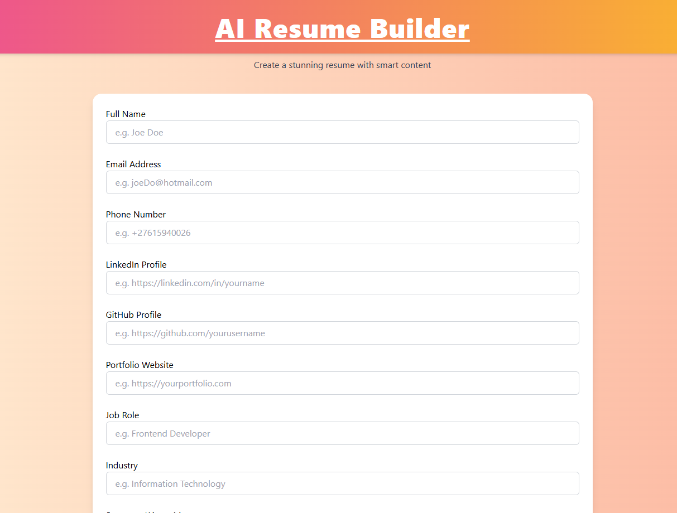
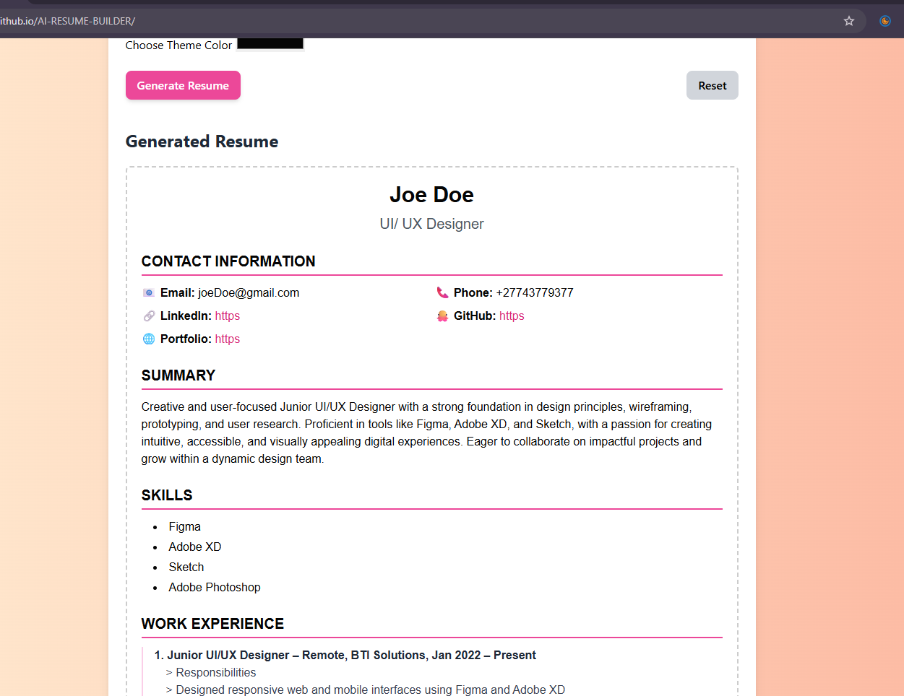
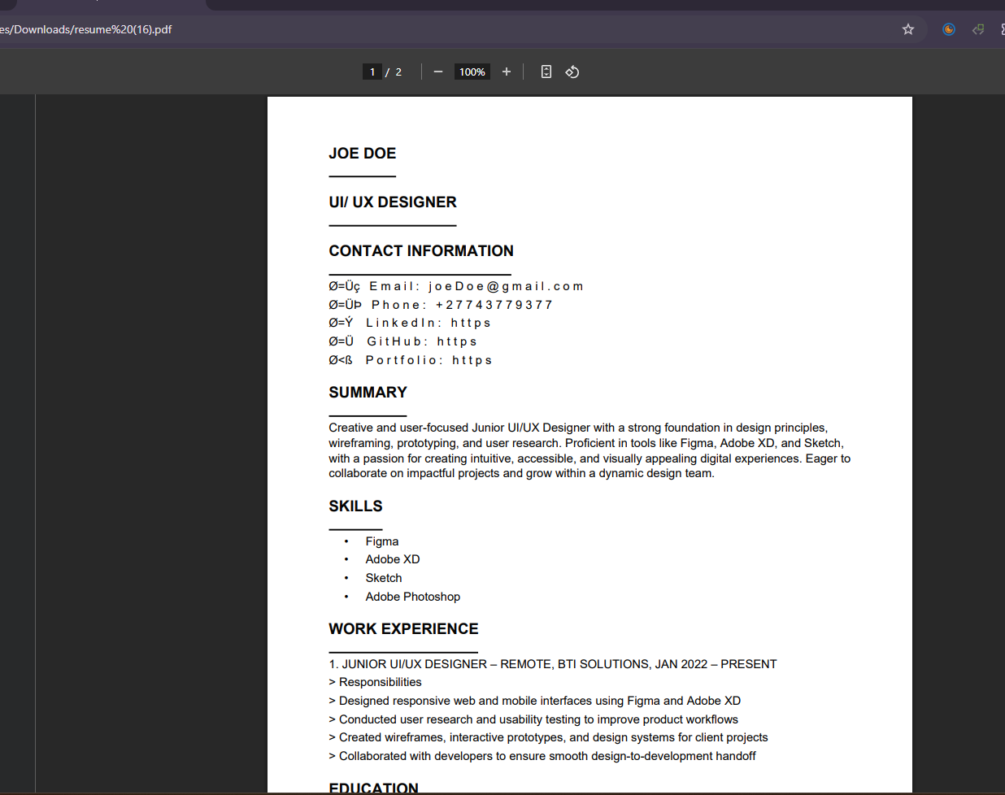
Built with HTML, Tailwind CSS, JavaScript, and OpenAI API.

Slide 9
Enhanced Requirements - Feedback Loop
Continuous Improvement: Incorporate a feedback mechanism.
User-Driven Enhancements: Outputs improve over time based on user edits and interactions.
Adaptive AI: The system learns and refines its suggestions

Slide 10
Technical Specifications (Detailed)
User Interface: Clean and responsive UI for efficient data input.
Preview Capability: Section-by-section preview of the resume as it's built.
Data Storage: Local storage of user data to ensure privacy.
API Documentation: Clear documentation of all API usage and their limitations.
Cross-Browser Compatibility: Ensure the application functions seamlessly across various web browsers.

Slide 11
Evaluation Criteria
User Experience Intuitiveness: How easy and intuitive is the application to use?
Output Quality & Customization: Effectiveness and customization options of the generated resumes.
Technical Implementation Robustness: Stability, efficiency, and quality of the code.
Documentation Completeness: Clarity and comprehensiveness of all project documentation.
Innovation in AI Application: Creativity and effectiveness in leveraging AI functionalities.

Slide 12
Conclusion & Q&A summary: the ai resume builder aims to revolutionize resume creation through intelligent automation and personalized content. future vision: continuous enhancement of ai models, expansion of template libraries, and integration with job platforms.
Thank you
Questions?

